Slide 1


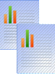





Machine Performance Analytics using Machine learning @ Sterlite
Business Drivers
Customer wanted a Dashboard to Visualize how the gases flowed for a particular run of the machine
Fit non linear least squares to each variable of each run to and visualize the variability of machine over time.
Map the parameters of the variables with quality parameters of fiber to understand the correlation of each process and its variability
Key Highlights
1 Tableau and 1 Rshiny Dashboard
20+ scientists and Executives
Solution Highlights
Cognizant’s provided the following solution:
Gathered requirements, designed and implemented Tableau Dashboard to visualize each run of the machine.
Implemented Non linear least squares curve fitting and piecewise continuous regression to obtain parameters and are presented in Rshiny Dashboard.
Mapped the outcome quality parameters with parameters to understand the correlation
13 GB data/Year
3 environments
Technology Stack: R, RShiny| Tableau | Database: Oracle
Business Outcome
Identified many inconsistencies in the data generated by the machine
Helped R&D team to understand the causes of variation in quality
A deeper look into how the machines are running and variation over time

Slide 2

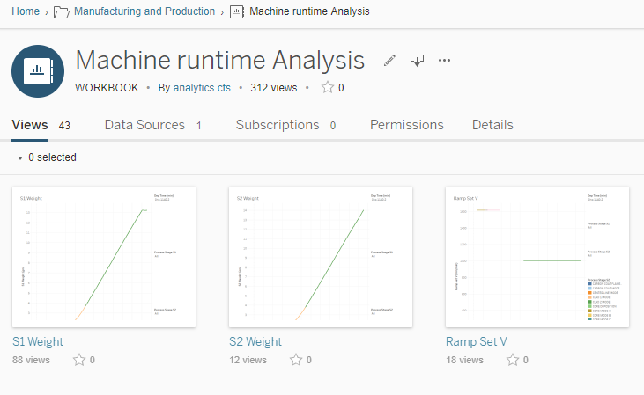
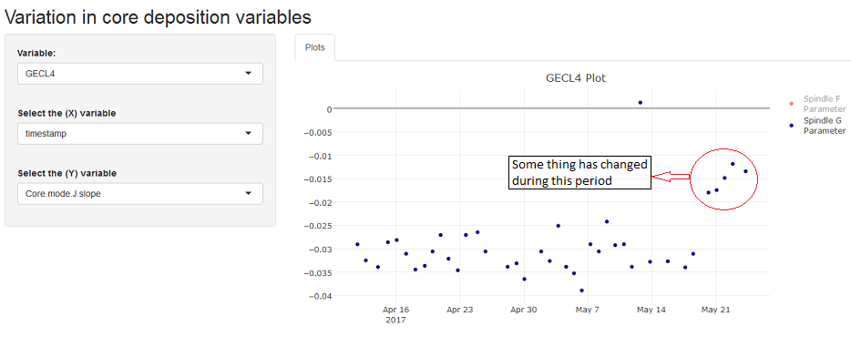



Machine Performance Analytics using Machine learning @ Sterlite
Solution Details
Better understanding of the root causes for variation in quality
Help reduction in the scrap and increase the production
A deeper understanding of how the machine is behaving over time
Value adds
It is complex to compare each run with other. So, to solve this issue we used a technique called parameterization. Parametrization is the process of finding parametric equations of a curve.
Data is inconsistent, files are corrupted, and some runs end abruptly due to failures.
Data is read from csv files for each run individually
Challenges Faced
Tableau Dashboard to visualize gases flow of each run individually
A shiny Dashboard which show the behavior of the machines over the time. Each variable and its parameters are plotted over time.

Slide 3
Machine Performance Analytics using Machine learning @ Sterlite (Addendum – For internal use only)
Project Details
Project start and completion date/ Duration | February 2017 – Sep 2017
Project Manager (Onsite/Offshore)/POCs
Portfolio Director - needs to sign off on the case study
Peak team size | 1(On-site)
Service line involved | Business Analytics
COE involved
Onsite/offshore Ratio
Location of the project | Onsite: Aurangabad, IN;
Key themes | Machine Learning and Data Visualization
Any unique highlights of the project | Received appreciation from CEO and CTO of the client for the insights discovered
Client LoBs/ BU involved | R&D

